Slide 1
Counting the Cell
Lu An Tang

Slide 2

Outline
Terms used in this problem
Counting the cuboids and cells
Suggestion for the exams

Slide 3
First, Let’s make clear some terms
The following descriptions are not formal, just help you to understand the intuitions of those concepts:
(Data) Cube: General name of the data model, it refers to the technique or model, such as Iceberg cube, ranking cube, text cube …… It is non-countable ☺
Cuboid: data summarization on a subset of cube’s dimensions (e.g., [location, time, branch; sales (measure)])
Cell: a specific unit of the cuboid (e.g, [Urbana, 2009, Wal-Mart; 10M sales])

Slide 4
Data Cube is a lattice of cuboids (CS412 PPT )
all
0-D(apex) cuboid
time
item
location
supplier
1-D cuboids
time,location
item,location
location,supplier
2-D cuboids
time,item
time,supplier
item,supplier
time,location,supplier
3-D cuboids
time,item,location
time,item,supplier
item,location,supplier
4-D(base) cuboid
time, item, location, supplierc
Data Mining: Concepts and Techniques

Slide 5
Cuboid is a set of cells (CS412 PPT )
Cuboid ABC is a set of cells, such as (a0,b0,c0), (a0,b0,c2) … The measure is omitted here
C
c3
61
62
63
64
c2
45
46
47
48
c1
29
30
31
32
c 0
B
60
b3
13
14
15
16
44
B
9
28
56
b2
40
5
24
52
b1
36
20
b0
1
2
3
4
a0
a1
a2
a3
A
Data Mining: Concepts and Techniques

Slide 6
Base and aggregate cells/cuboids
Suppose there are totally n dimensions
The fact table (n-D cuboid) is called a base cuboid, the cells in base cuboid are called base cells or base tuples. Indeed they are the relational tuples
The top most 0-D cuboid is called the apex cuboid
Except the base cuboid, all the cuboids are aggregate cuboids, their cells are aggregate cells

Slide 7

Non empty
For example, if there is no record of Chicago’s Wal-Mart in the fact table
Then, the cell (Chicago, 2009-10, Wal-Mart) is empty
And all the following cells are empty, too
  (Chicago, 2009-9, Wal-Mart); (Chicago, 2009, Wal-Mart)
  (Chicago, *, Wal-Mart)
Will there be “empty cuboid”?
As long as there is one tuple existing in the fact table, there will be no empty cuboid, e,g., (Location, time, branch) will never be empty even if there is only one tuple in fact table

Slide 8
Short Summary
Cube: A general name, you will never be asked to count a “cube”
Cuboid: A subset of the dimensions in data cube, if the fact table is not empty (no one will ask you to count an empty cube…), then there will be no empty cuboids
Cell: A specific unit of the cuboid
Aggregate Cuboid: All the cuboids except the base cuboid

Slide 9
Outline
Terms used in this problem
Counting the cuboids and cells
Suggestion for the exams

Slide 10
Example Question
Assume a base cuboid of 20 dimensions contains 3 base cells, as shown below,
  (1) (a1, b2, b3; b4…… , b20)
  (2) (b1; a2; b3; b4 ……, b20)
  (3) (b1, b2, a3; b4 ……, b20)
where a_{i} ≠b_{i}. The measure is count.
1. How many nonempty aggregated cuboids will this full data cube contain?
2. How many nonempty aggregated cells are there?
3 How many nonempty aggregated cells are there for the iceberg cube with count ≥2 ?

Slide 11
The symbols we will use in the following slides
More generally, suppose there are n dimensions in the cube, and p base cells in the base cuboid. Among the p cells, there are c common dimensions
Example
  (1) (a1, b2, b3; b4…… , b20)
  (2) (b1; a2; b3; b4 ……, b20)
  (3) (b1, b2, a3; b4 ……, b20)
Total dimension n = 20
Number of base cell p = 3
Common dimension (b4 … b20) c = 20-3 =17

Slide 12
Counting the Number of Cuboids
Rule 1: The number of cuboids has no relation to the number of base cells
If there is no concept hierarchy (most questions are in this case), the formula to compute the cuboid is
Total Cuboid number = 2^{n} (n is the number of dimension)
Example question 1:
n = 20, the total number of cuboids is 2²⁰.
Number of nonempty aggregated cuboids = 2²⁰ – 1

Slide 13
Strategy for Counting the Number of Cells
Calculate the total number of cells;
Calculate the overlapping cells;
Answer = Total – overlapping cells*overlapping times

Slide 14
What is overlapping?
Suppose we have two base cells
  (Urbana, 2009, Wal-Mart) count: 1
  (Chicago, 2009, Wal-Mart) count: 1
If we roll up in the location dimension to *, both the two cells will be:
(*, 2009, Wal-Mart) count: 2
Here two cells overlap as one cell. The cell’s count is 2. We call it overlap once/1 time.

Slide 15
Calculate the total number of cells
Formula: Total Cell number = p*2^{n}
In the example question, p = 3, n = 20
Total cell number = 3*2²⁰

Slide 16


Calculate the overlaps I
Strategy:
Start from the max count, then reduce one by one, stop until count = 1
The max possible count in the example is 3 (since there are only 3 base cells in the fact table)
Except common dimensions, if we set all other dimensions as *, no matte how we select other dimensions, then the count will always be 3. e.g.,
  (*,*,*, b4……b18, * , b20) count 3
  (*,*,*, b4, *, b6……, b20) count 3
  (*,*,*,*……*) apex cell, count 3
So how many are those count 3 cells?

Slide 17
Calculate the overlaps II
Formula: Number of Max count cells (Count 3 cells) = 2^{c} (c is the number of common dimensions)
In the example question, c = 17
Count = 3 cells (overlap 2 times) 2¹⁷
The next step is to compute count = 2 cells (overlap 1 time)

Slide 18
Calculate the overlaps III
Unfortunately there is no formula in this step, we have to count by ourselves
  (1) (a1, b2, b3; b4…… , b20)
  (2) (b1; a2; b3; b4 ……, b20)
  (3) (b1, b2, a3; b4 ……, b20)
How can count = 2 cells (overlap once) happen?
If we set the first two dimensions as “*”, then it will be
  (*, *, b3; b4 ……, b20) count 2
  (*, *, a3; b4 ……, b20) count 1

Slide 19
Calculate the overlaps IV
And remember, each common dimensions may be “bi” or *, e.g.,
  (*, *, b3; b4 ……, b20) count 2
  (*, *, b3; *, b5……, b20) count 2
  (*, *, b3; *, ……, *) count 2
So for this case, there are also 2¹⁷ cells

Slide 20
Calculate the overlaps V
So how many count = 2 cells in total?
In this question, there are three cases, each has 2¹⁷ cells
  (b1, *, *)
  (*, b2, *)
  (*, *, b3)
Count = 2 cells (overlap 1 times), 3* 2¹⁷

Slide 21
Calculate the final answer
Question 2. Final Answer is:
Total cell – overlap twice cells *2 – overlap once cells *1 – base cells
3*2²⁰ - 2 * 2¹⁷ - 1* 3* 2¹⁷ – 3 = 3*2²⁰ - 5* 2¹⁷ – 3

Slide 22
Calculate the Iceberg cells
With our previous result, it is quite easy to calculate the iceberg cells
Iceberg cells = count 3 cells + count 2 cells
Answer = 2¹⁷ + 3* 2¹⁷ ⁼ 4* 2¹⁷

Slide 23
Outline
Terms used in this problem
Counting the cuboids and cells
Suggestion for the exams

Slide 24
Some suggestions to deal with this problem in exam
"Counting cells" in the data cube is a classic problem – and it is likely to appear in the mid-term and final exams
Frankly speaking, this question is the most difficult problem; but in the exam, it usually appears as question 2 or question 3
Strategy: Control you time spending on this question
Usually the first sub question is counting the cuboid – and it is easy, you can quickly answer it.

Slide 25
Some suggestions II
For the question of counting cells, if you are not very confident, you can leave it as the last one to solve in the exam (especially the mid-term’s time is only 1.5 hours)
When solving the question, try to list out every steps
The calculations are error-prone, but as long as your steps are right, you can get some points even with wrong answer
An example solution is in the next page

Slide 26
Example Question
Assume a base cuboid of 20 dimensions contains 3 base cells, as shown below,
  (1) (a1, b2, b3; b4…… , b20)
  (2) (b1; a2; b3; b4 ……, b20)
  (3) (b1, b2, a3; b4 ……, b20)
where a_{i} ≠b_{i}. The measure is count.
1. How many nonempty aggregated cuboids will this full data cube contain?
2. How many nonempty aggregated cells are there?
3 How many nonempty aggregated cells are there for the iceberg cube with count ≥2 ? (1 point)

Slide 27
Example Solution I
1. Total dimension n = 20; Number of base cell p = 3
Common dimension (b₄ to b₂₀) c = 20-3 =17
The total number of cuboids is 2²⁰. Base cuboid is 1
The number of nonempty aggregated cuboids = 2²⁰ – 1
2. Total cell number = 3*2²⁰
Count 3 cells (overlap 2 times), 2¹⁷
Count 2 cells (overlap 1 times), 3* 2¹⁷; Base cells, 3
The number of nonempty aggregated cells:
3*2²⁰ - 2 * 2¹⁷ - 1* 3* 2¹⁷ – 3 = 3*2²⁰ - 5* 2¹⁷ – 3

Slide 28
Example Solution II
3. Iceberg cells = count 3 cells + count 2 cells
nonempty aggregated cells with count ≥2:
2¹⁷ + 3* 2¹⁷ ⁼ 4* 2¹⁷

Slide 29
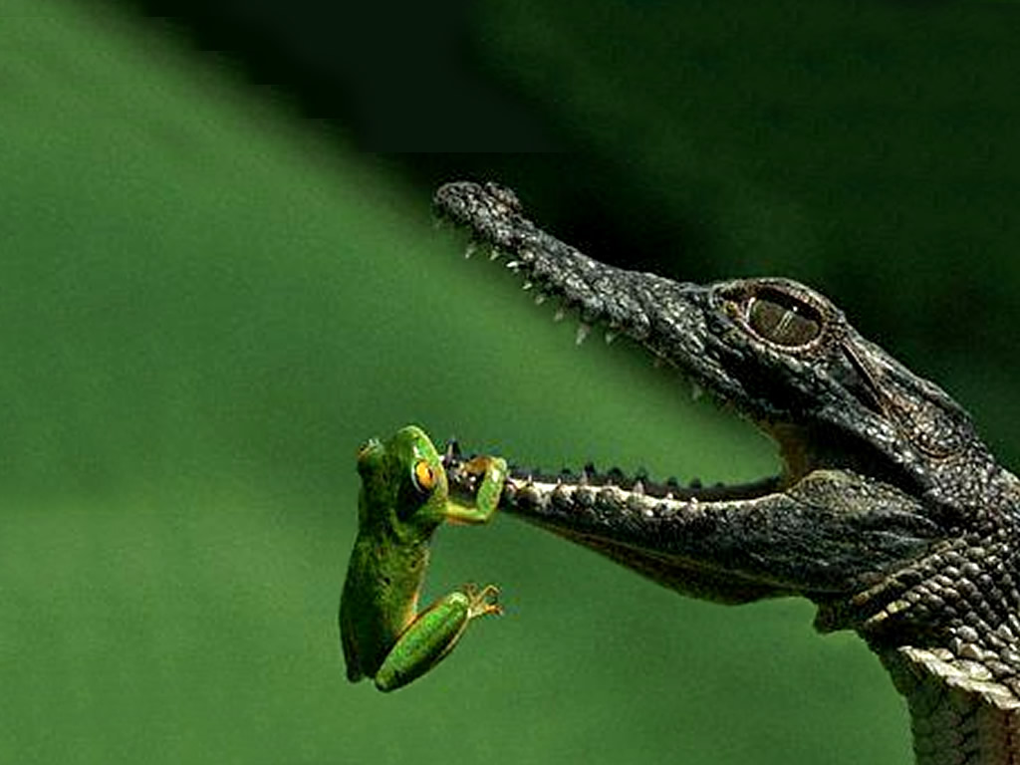
Thank You Very Much! Good luck in the Exams!

